Slide 1

RSHE parent information talk June 2021
Dale Hall Community Primary School

Slide 2
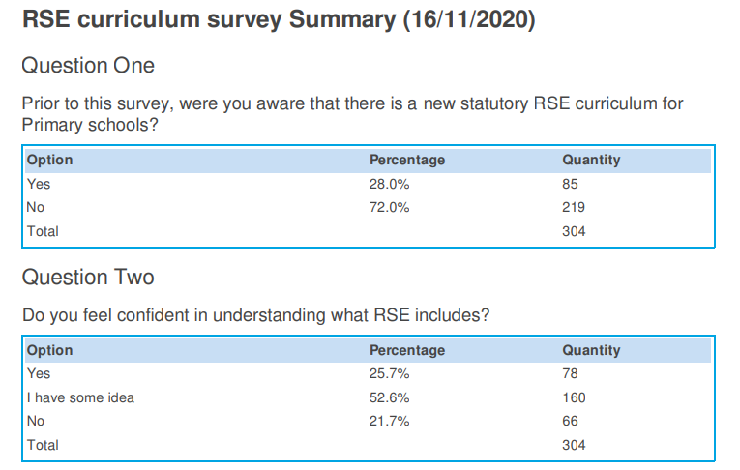
Parent survey results

Slide 3

Why is RSHE so important?
Children need to be able to embrace the challenges of creating a happy and successful adult life.
Pupils need knowledge and skills that will enable them to make informed decisions about their wellbeing, health and relationships.
Pupils need the ability to make sound decisions when facing risks, challenges and complex contexts.
Pupils need to develop resilience and to know how and when to ask for help and where to access support.

Slide 4

New statutory guidance
20 years since RSE curriculum last reviewed!
The new guidance sets out what must be taught in both Primary and Secondary and the legal duties of schools regarding Relationships and Sex education
Schools are free to decide how they deliver the content within their current PSHE curriculum.
The guidance ensures that our curriculum is in line with the Equality act 2010

Slide 5
Why is RSHE even more important now?
The new RSE guidance for schools becomes statutory for all schools in September 2021.
The Covid 19 school closures really did mean unprecedented times for schools and families. Some relationships were strengthened but others were markedly strained.
Updating RSHE to ensure it is relevant to young people’s lives, supported by their families and provided in a timely and inclusive way, is long overdue.
We are all still adjusting to a ‘new normal’ and will be for some time to come…

Slide 6
Our policy at Dale Hall
Our statement:
At Dale Hall we value that young people are growing up in an increasingly complex world. This presents many positive and exciting opportunities, but also many challenges and risks.
In this environment, children and young people need to know how to be safe and healthy, and how to manage their academic, personal, emotional, moral and social lives in a positive way. At Dale Hall we work hard to provide a framework in which sensitive discussions can take place.
At Dale Hall RSHE combines
PSHE- personal, social, health and economic (PSHE) education curriculum.
Science- Biological aspects are taught within the Science curriculum
RE- other aspects are included in religious education (RE).

Slide 7
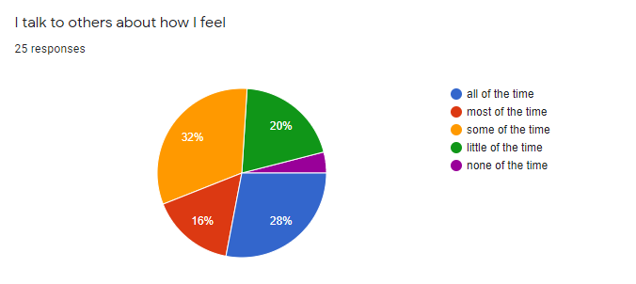
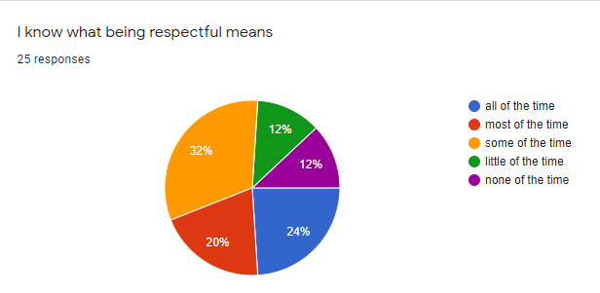
EYFS pupil survey
Only 28% of pupils said all of the time.
We would like 100% of pupils to be confident with what respect means.

Slide 8
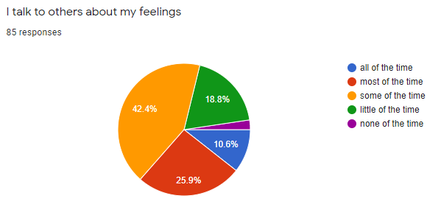
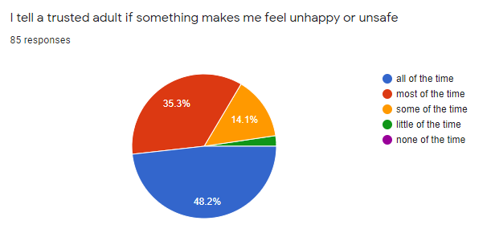
Year 1-3 pupil survey results
Only 10% of pupils said all of the time.
We would like 100% of pupils to be confident with telling a trusted adult.

Slide 9
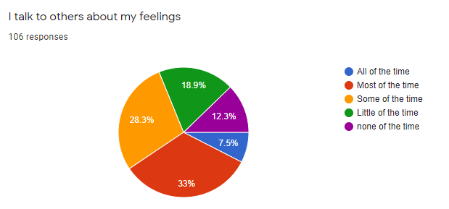
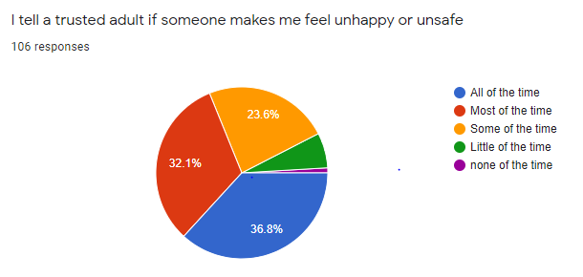
Year 4-6 pupil survey results
Only 7.5% of pupils said all of the time.
We would like 100% of pupils to be confident with telling a trusted adult.

Slide 10
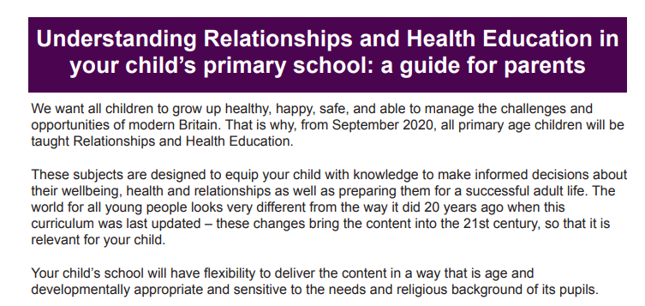
Government info for parents

Slide 11
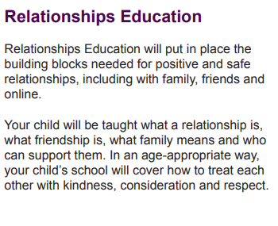
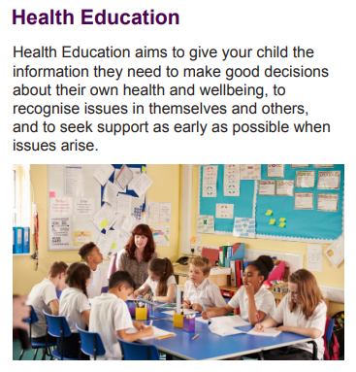

Slide 12
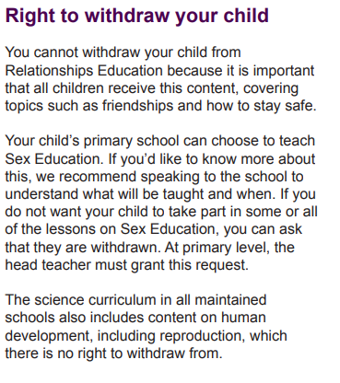
Parent information
The new government guidance requires that schools involve parents and carers in planning and recommends ongoing communication with them about what will be taught and when.
Parent consultation- Earlier in the school year I set up a parent working group. We had a small group of volunteers of parents from Rec-Year 6 who helped with creating the Dale Hall policy and ensuring it met the needs of our pupils.
Schools must have a written policy for RSE and relationships education which is available to parents.
This policy will be shared with parents once it has been approved by governors next week.

Slide 13
Why are parents so crucial for RSHE to be successful?
You as parents/carers at Dale Hall:
•have already supported the school to shape the curriculum for relationships, health and sex education
•will communicate openly and constructively with school staff regarding relationships, health and sex education
•will model positive attitudes to relationships, health and sex education.
•will support your child by having open and honest follow up conversations at home

Slide 14





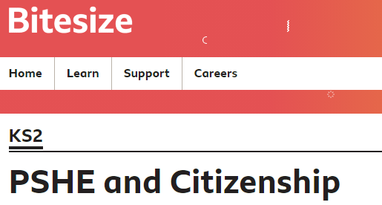

What resources do our teachers have access to?
PSHE - BBC Teach
PSHE Twinkl - Google Drive
Toolbox | Childline
Agenda
KS2 PSHE and Citizenship - BBC Bitesize
Teaching resources and lesson plans | NSPCC Learning

Slide 15
So what’s next for Dale Hall?
-Policy to be approved by governors
-Policy to be shared with parents
-Curriculum to become statutory from September 2021
-Staff training to continue

Slide 16
Please get in contact if you have any further questions or would like to be involved in any future working group activities.
Thank you so much for listening today.

